Slide 1

ACADEMIC PROJECT PRESENTATION
Java & Database Application
Farmers Market Price & Sales Tracker
A Data-Driven Java Solution for Agricultural Price Transparency, Sales Ledger Management, and Market Intelligence
PRESENTED BY
Rohit krishna sai maddina — 2620040145
varshith kilaru — 2620040135

Slide 2



01. Core Challenges
Problem Statement
Price Asymmetry
Manual Record-Keeping
Middlemen Exploitation
Farmers lack real-time mandi rate visibility, forcing distress sales below fair market value.
Paper logbooks cause frequent calculation errors, record loss, and untracked sales credit.
Opaque intermediary margins reduce net farmer earnings despite strong end-consumer demand.

Slide 3

02. Project Goals
Key Objectives
Real-Time Price Logging
Automated Sales Tracking
Daily updates for produce rates across regional markets.
Instant revenue summary and transaction ledger logging.
Structured Data Storage
Sales Trend Analytics
Reliable Java & SQL relational database management.
Visual insights into high-demand produce categories.

Slide 4
03. Baseline Analysis
Existing System Limitations
TRADITIONAL METHOD
STATIC DISCOVERY
NO INSIGHTS
Physical Ledger Books
Chalkboard Price Dissemination
Zero Analytical Capability
Heavy reliance on paper registers causing physical damage and untracked transactions.
Static market boards updated once daily without historical price comparison.
Inability to forecast seasonal crop demand or evaluate monthly revenue metrics.

Slide 5
04. Modernized Architecture
Proposed System Advantages
Dynamic Price Sync
Automated Billing
Role-Based Security
Instant rate modification with minimum, modal, and maximum market prices.
Instant receipt generation with quantity calculation and customer logging.
Dedicated admin portal for price validation and farmer sales access.

Slide 6
05. System Design
System Architecture
PRESENTATION LAYER
Java Swing / JavaFX Graphical User Interface (Forms, Price Boards, Sales Reports)
BUSINESS LOGIC
Java Controllers (PriceManager.java, SalesTracker.java, ValidationEngine.java)
DATABASE LAYER
JDBC Driver connected to MySQL / SQLite Database (Farmers, Crops, Mandi Rates, Sales Log)

Slide 7
06. Modules & Capabilities
Key System Functionalities
Produce Catalog
Daily Price Updates
Sales Entry Module
Report Generator
Categorize crops by variety, grade, unit (Kg/Quintal), and local origin.
Input min, max, and modal rates per market with date stamp records.
Record transaction quantities, buyers, payment mode, and net earnings.
Export monthly revenue summaries and crop sales performance analytics.

Slide 8
07. Backend Logic
Implementation – Java Code Snippets
SalesTrackerDAO.java
JDBC Controller Method
import java.util.Scanner;
public class FarmerMarket {
public static void main(String[] args) {
Scanner sc = new Scanner(System.in);
System.out.print("Enter crop name: ");
String crop = sc.nextLine();
System.out.print("Enter price per kg: ");
double price = sc.nextDouble();
System.out.print("Enter quantity sold (kg): ");
double quantity = sc.nextDouble();
double total = price * quantity;
System.out.println("\n--- Sales Details ---");
System.out.println("Crop: " + crop);
System.out.println("Price per kg: ₹" + price);
System.out.println("Quantity sold: " + quantity + " kg");
System.out.println("Total Sales: ₹" + total);
}
}
i

Slide 9

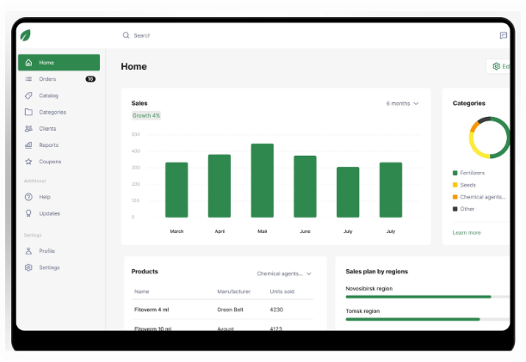
08. User Interface
Output Screenshots & Application Dashboard
Live Price Board View
Real-time mandi crop rate displays with daily fluctuation indicators.
Sales Logging Module
Form inputs for fast invoice entry and instant revenue calculations.
Financial Report Summary
Visual revenue breakdown categorized by crop yield type and month.

Slide 10


09. Expansion
Future Scope & Enhancements
AI Price Forecasting
Android / Mobile App
UPI Payment Gateway
Predict future mandi rates using Machine Learning based on weather and historical yield.
Cross-platform mobile client with regional language support and SMS alerts for farmers.
Direct digital payouts and instant transaction settlements without physical cash delay.

Slide 11
10. Summary
Conclusion
Digitized Management
Empowered Farmers
Robust Java Backend
Successfully replaced manual paper registers with an automated Java desktop application.
Improved price awareness enables farmers to negotiate fair market value for produce.
Modular SQL architecture ensures data integrity, fast query response, and scalability.

Slide 12

Thank You!
Questions & Answers
Rohit krishna sai maddina (2620040145)
|
varshith kilaru (2620040135)

